Slide 1


Slide 2

Required program for XNA
Step 1

Slide 3
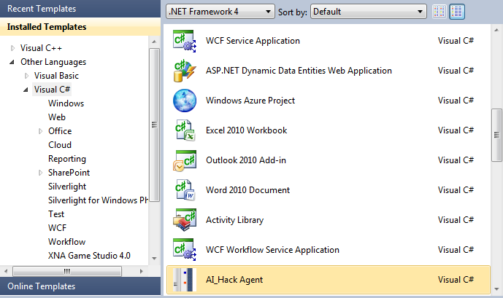
AI_Hack Agent Setup
1- Move AI_Hack folder to C:\
2- Setup Microsoft Visual Studio 10 C#
3-Run Setup

Slide 4
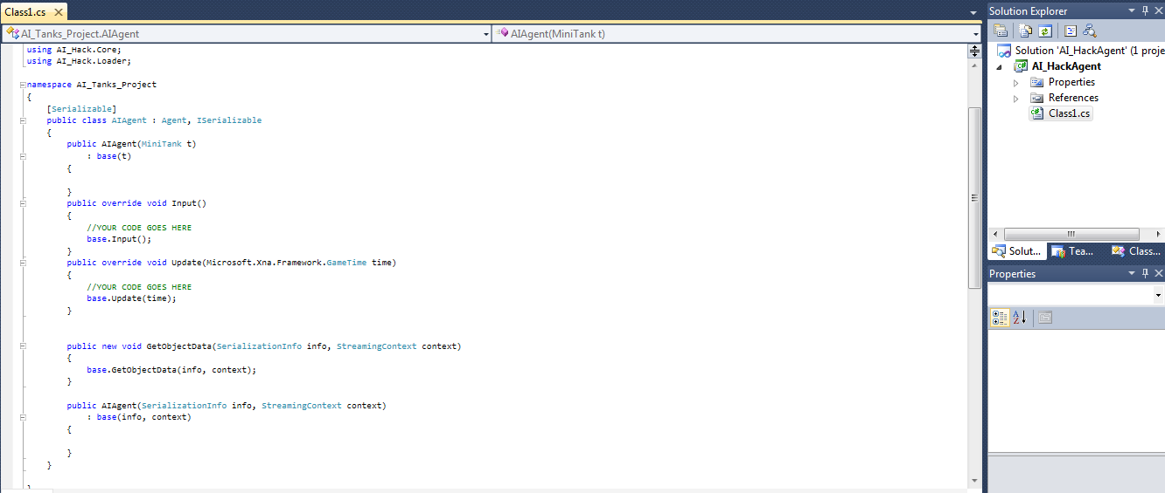
Code your Agent
Open

Slide 5
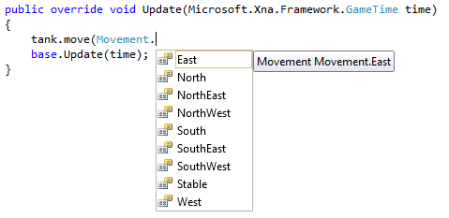
Code your Agent
Move

Slide 6

Code your Agent
Fire

Slide 7

Code your Agent
Health

Slide 8
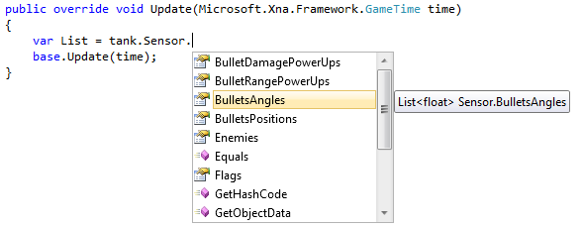
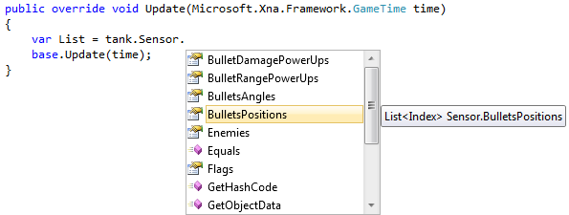
Code your Agent
Bullets List

Slide 9
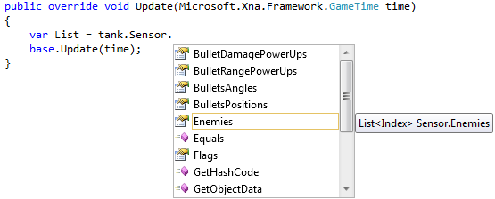
Code your Agent
Enemies List

Slide 10
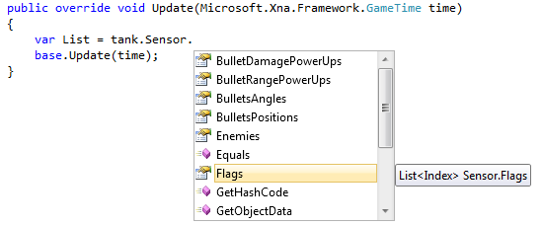
Code your Agent
Flags List

Slide 11
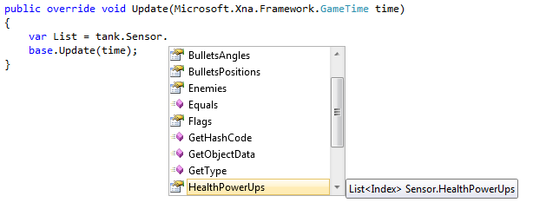
Code your Agent
Health power-up List
+10

Slide 12
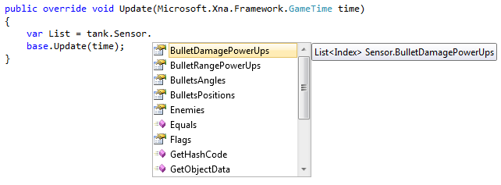
Code your Agent
Bullet’s Damage power-up List
+5

Slide 13
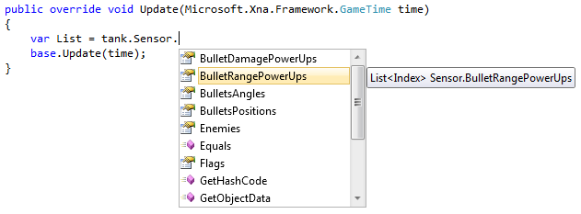
Code your Agent
Bullet’s Range power-up List
+3

Slide 14
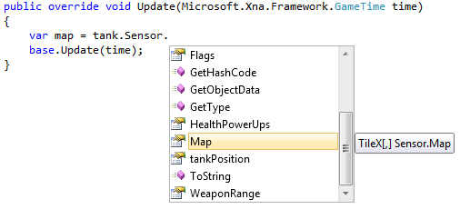
Code your Agent
Map

Slide 15
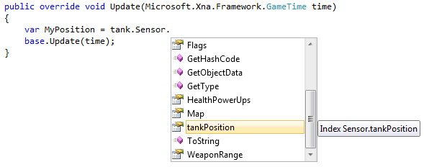
Code your Agent
Tank Position

Slide 16
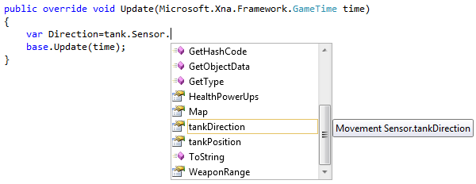
Code your Agent
Tank Direction

Slide 17
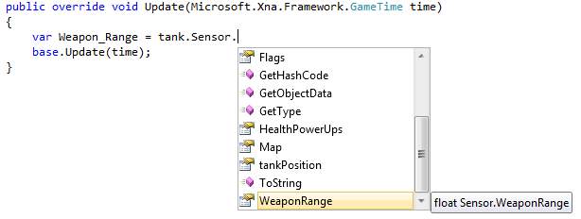
Code your Agent
Weapon Range

Slide 18
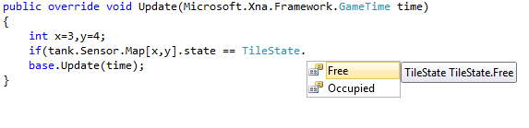
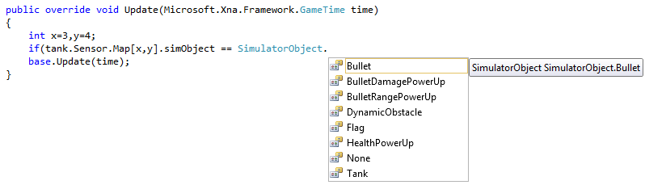
Code your Agent
Tile State & Objects

Slide 19
Tile Editor
Open

Slide 20
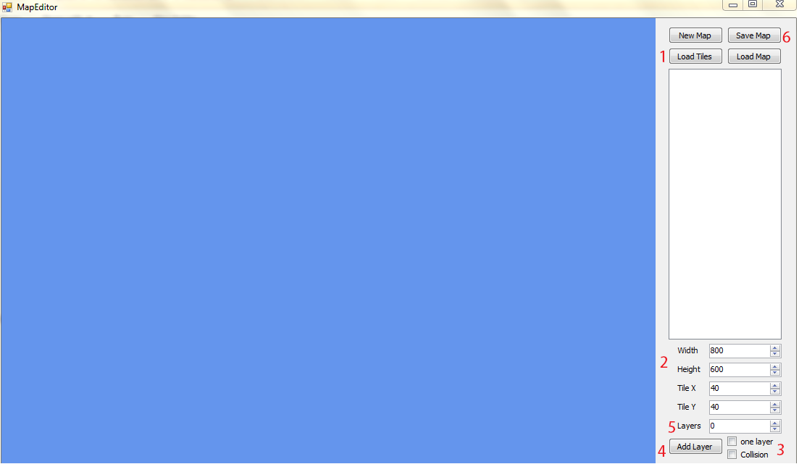
1- Load Tiles

Slide 21
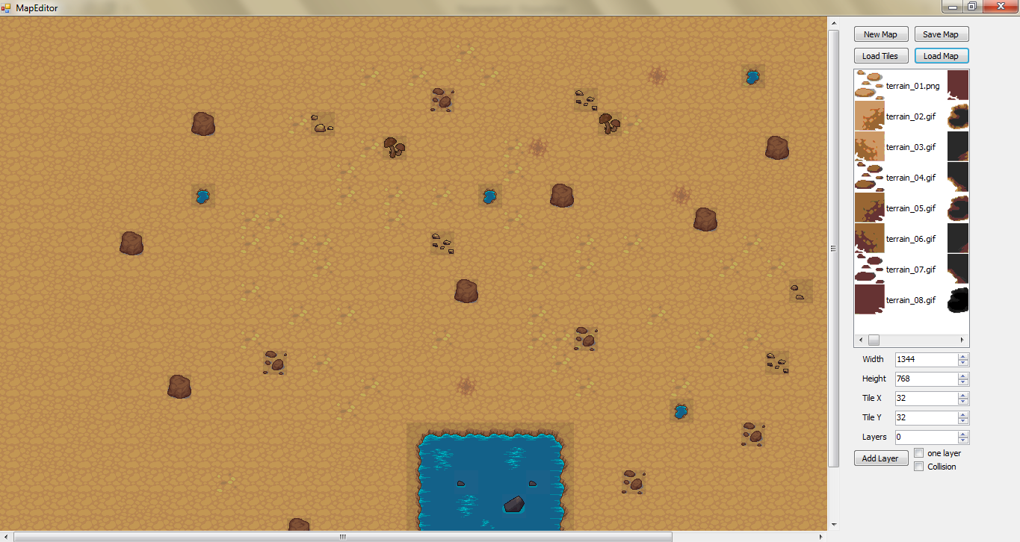

Slide 22

AI Hackathon
Open

Slide 23
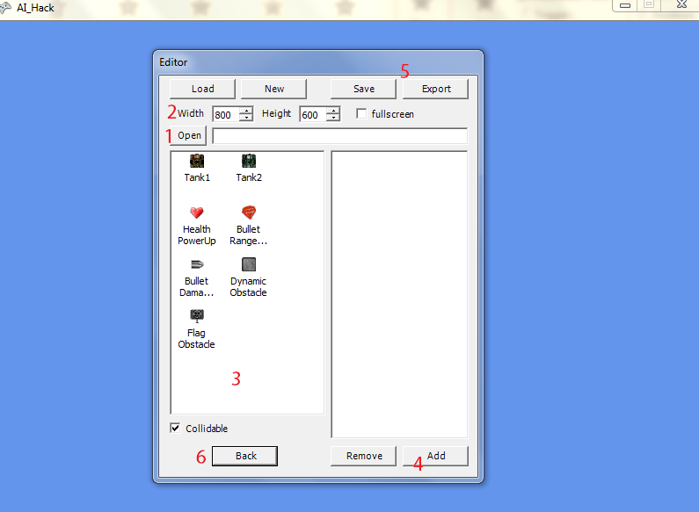
Edit Scene
1- Open your map from Tile Editor.
3- Click and put in map.
4- Click on Tank on the map then click Add then choose dll from your Agent.

Slide 24
AI Hackathon

Slide 25
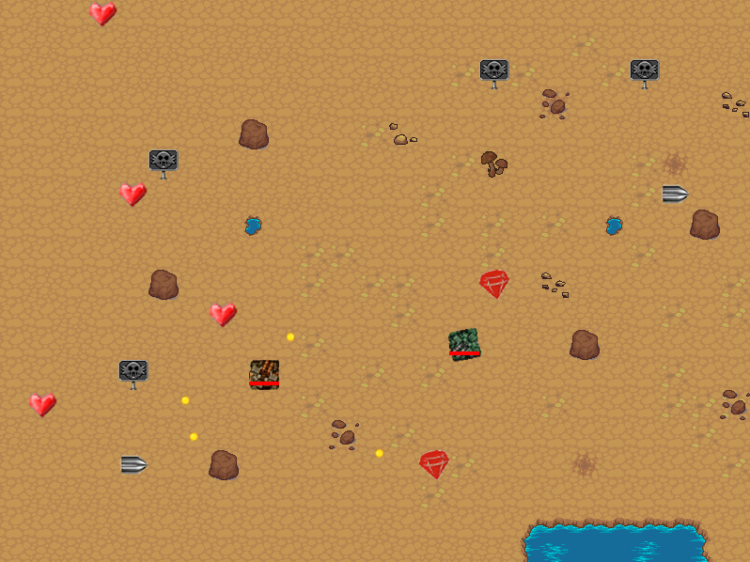
AI Hackathon

Slide 26
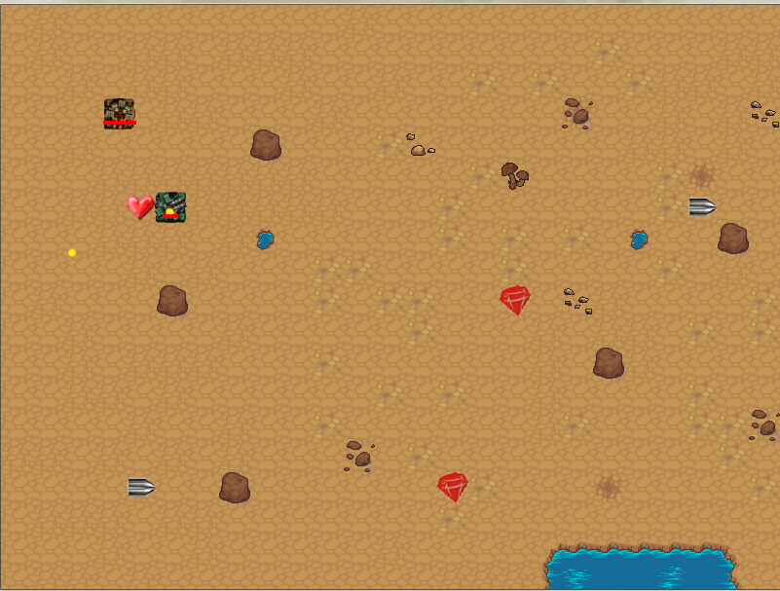
AI Hackathon

Slide 27
Let’s Try

Slide 28
Thank you

